Slide 1
DLD PROJECT
TITLE :
4 – BIT ARITHMETIC
LOGIC UNIT (ALU)

Slide 2
GROUP MEMBERS :
ABDUL BASIT (20K-0333)
YASIR JAMAL (20K-0158)
ANAS HASSAN (20K-1726)
MUHAMMAD WARZAN (20K-1649)

Slide 3
APPLICATION AND
MOTIVATION:
An Arithmetic and Logic Unit (ALU) is a digital circuit used to perform arithmetic and logic operations . It represents the fundamental building block of the Central Processing Unit (CPU) of a computer.
Since ALU is the most basic and fundamental part of the C.P.U , capable of performing all basic operations . So , it motivates us to design such project which is capable of executing such operations .

Slide 4
DIFFERENT MODULES OF PROJECT :
ADDITION (HARDWARE AND SOFTWARE )
SUBTRACTION (HARDWARE AND SOFTWARE )
COMPARATORS (HARDWARE AND SOFTWARE )
4. MULTIPLICATION (ONLY SOFTWARE )

Slide 5
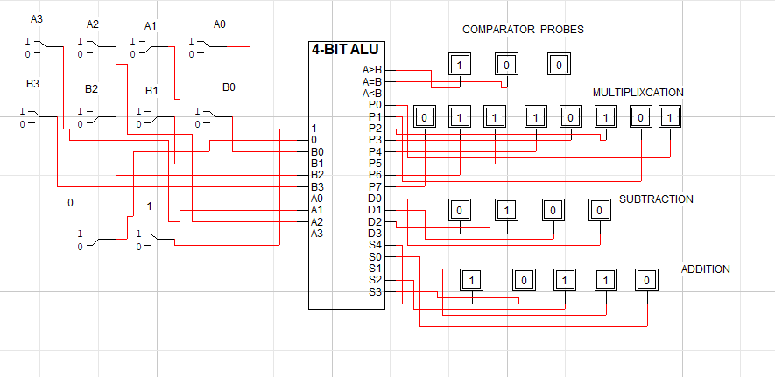
OUTPUT OF CIRCUIT:

Slide 6
WORKLOAD DISTRIBUTION :
All members of the group have equally participated in the hardware implementation of project but the workload distribution is given below.
Abdul Basit (20K-0333) and Yasir Jamal (20K-0158) mainly worked on comparator circuit .
Anas Hassan (20K-1726) and Muhammad Warzan (20K-1649) worked on addition and subtraction circuit.

Slide 7
CONCLUSION :
We have tried our best to design 4- bit ALU but unable to perform hardware implementation of multiplication due to less components and the current situation of the city but have completed with software implementation .We hope that you will surely like our project.
>>>>>>> THANKING YOU <<<<<<<<<<<

